Slide 1


Distributed kNN Using
RAY FRAMEWORK
Master of Computer Applications
PRESENTED BY: Sakshi Anand (23MCMC19)
Harshit Agarwal (23MCMC37)
GUIDED BY:
Dr. P.S.V.S SAI PRASAD
PRESENTED BY:
SAKSHI ANAND(23MCMC19)
HARSHIT AGARWAL(23MCMC37)

Slide 2
Content
Abstract
Introduction
Technology Stack
Problem Statement
About kNN
-Advantages
-Challenges
- Relevance
About Ray
-Ray Framework
-Ray Libraries
-Parallel Processing
-Why Ray?
Code Implementation
-Serial implementation of kNN without Ray
-Distributed implementation of kNN with Ray
Experimental Result
-Comparison with Traditional kNN
->Sequence kNN(Without Ray) for k=3
->Distributed kNN(Ray) for k=3
->Sequence kNN(Without Ray) for k=5
->Distributed kNN(Ray) for k=5
Future Work
Conclusion
References

Slide 3
Abstract
The rapid growth in data availability and computational needs has presented challenges for traditional algorithms like k-Nearest Neighbors (KNN), especially in large-scale data applications. KNN, known for its simplicity and effectiveness in classification tasks, struggles to scale due to its computational and memory-intensive nature.
This project addresses these limitations by leveraging Ray, a high-performance distributed computing framework, to implement a scalable and efficient distributed KNN algorithm. Ray’s ability to handle complex and parallel workloads enables significant improvements in both speed and scalability, making the distributed KNN a viable solution for big data challenges.

Slide 4
Introduction
The exponential rise in data generation demands efficient computational methods for processing large-scale datasets. Distributed computing has become essential for handling these challenges by leveraging multiple processors for task execution.
This project focuses on optimizing the K-Nearest Neighbors (KNN) algorithm, a simple yet computationally intensive machine learning technique, using the Ray framework. Ray’s distributed capabilities enable parallel processing, significantly improving KNN’s performance on large datasets while maintaining accuracy.
Key objectives include:
Understanding KNN’s computational challenges.
Exploring Ray’s architecture and scalability.
Demonstrating KNN’s parallel implementation using Ray.
This work exemplifies the role of distributed frameworks in advancing scalable machine learning solutions.

Slide 5
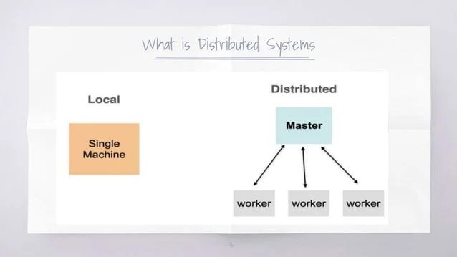

Slide 6
Technology Stack
Programming language: Python
Framework: Ray
Libraries: NumPy, pandas, Scipy, scikit-learn, Ray …., and time
GPU details:
-Model and Make: NVIDIA GeForce MX250
-Memory Size: 4GB
-Software: Python version: 3.10.9
Memory(RAM):
-Size: 8 GB
-Type and Speed: DDR4 2400 MHz
Processor(CPU):
-Model and Make: Intel(R) Core(TM) i5-10210U CPU
-Number of Cores and Threads: 4 cores, 8 threads(logical processors)
-Clock Speed: 1.6o GHz base, 2.11 GHz boost

Slide 7
Problem Statement
The k-Nearest Neighbors (kNN) algorithm is a cornerstone of machine learning, celebrated for its simplicity and accuracy. However, as dataset sizes and complexities grow, traditional kNN faces critical limitations:
Scalability Issues: Computational demands grow exponentially with dataset size.
Memory Overhead: Requires storing the entire training dataset in memory.
Inefficiency in High-Dimensional Data: Suffers from the "curse of dimensionality."
This project addresses these challenges by implementing a distributed kNN algorithm using Ray, optimizing for speed and scalability in large-scale data processing.

Slide 8
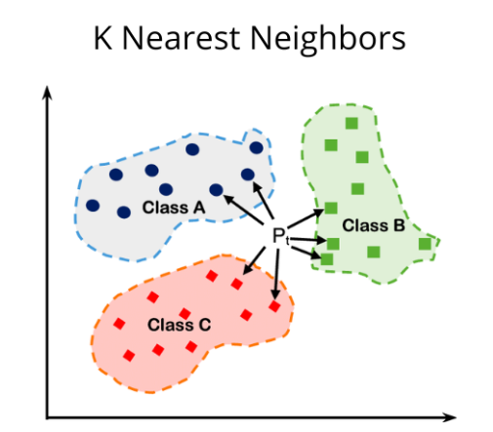
About kNN?

Slide 9
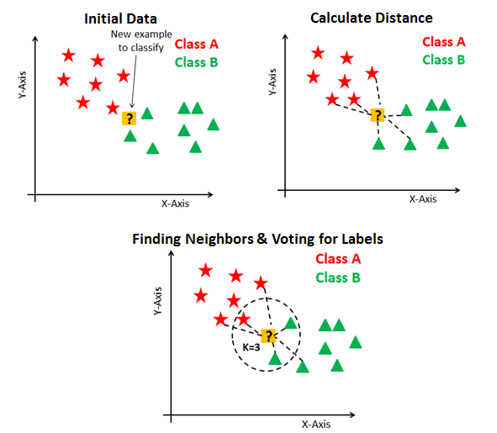
What is k-Nearest Neighbors (kNN)?
k-Nearest Neighbors (kNN) is a popular machine learning algorithm used for classification and regression tasks, where the goal is to predict an output based on the majority vote of a dataset’s nearest neighbors.
How it Works:)
Calculates the distance (e.g., Euclidean) between a query point and all training points.
Selects the k nearest neighbors based on the smallest distances.
Assigns the majority class (classification) or computes the average (regression).

Slide 11
Advantages
Simple to implement and intuitive to understand.
Can learn non-linear decision boundaries when used for classification and regression. Can come up with a highly flexible decision boundary adjusting the value of K.
No Training Time for classification/regression: The KNN algorithm has no explicit training step and all the work happens during prediction.
Single Hyperparameters: There is a single hyperparameter, the value of K. This makes hyperparameter tuning easy.
Choice of distance metric: There are many distance metrics to chose from. Some popular distance metrics used are Euclidean, Manhattan, Minkowski, hamming distance and so on.

Slide 12
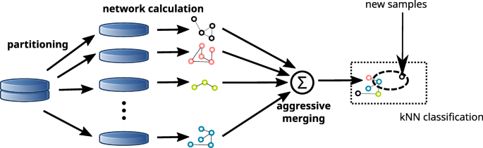
Challenges with Traditional kNN:
High computational cost for large datasets.
Memory-intensive due to lazy learning nature.
Sensitive to irrelevant or redundant features.
Relevance in the Project:
KNN’s computational challenges make it a suitable candidate for optimization using distributed frameworks like Ray.

Slide 13
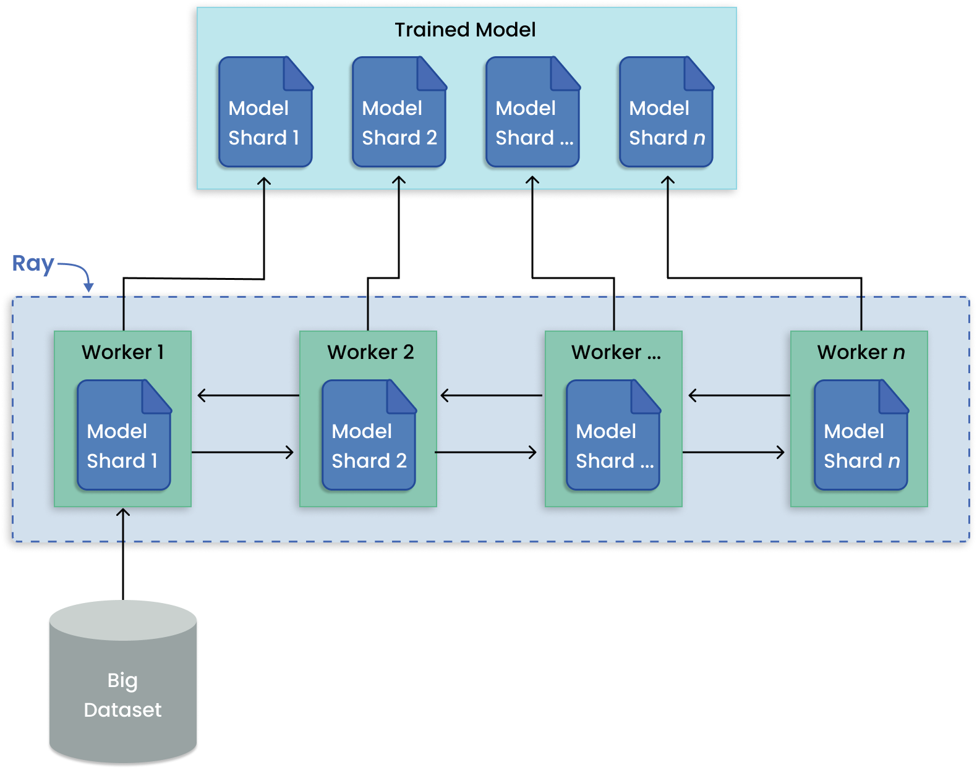

About
Ray

Slide 14

What is Ray?
Ray is an open-source unified framework for scaling AI and Python applications like machine learning. It provides the compute layer for parallel processing so that you don’t need to be a distributed systems expert. Ray minimizes the complexity of running your distributed individual and end-to-end machine learning workflows with these components:
Scalable libraries for common machine learning tasks such as data preprocessing, distributed training, hyperparameter tuning, reinforcement learning, and model serving.
Pythonic distributed computing primitives for parallelizing and scaling Python applications.
Integrations and utilities for integrating and deploying a Ray cluster with existing tools and infrastructure such as Kubernetes, AWS, GCP, and Azure.

Slide 15
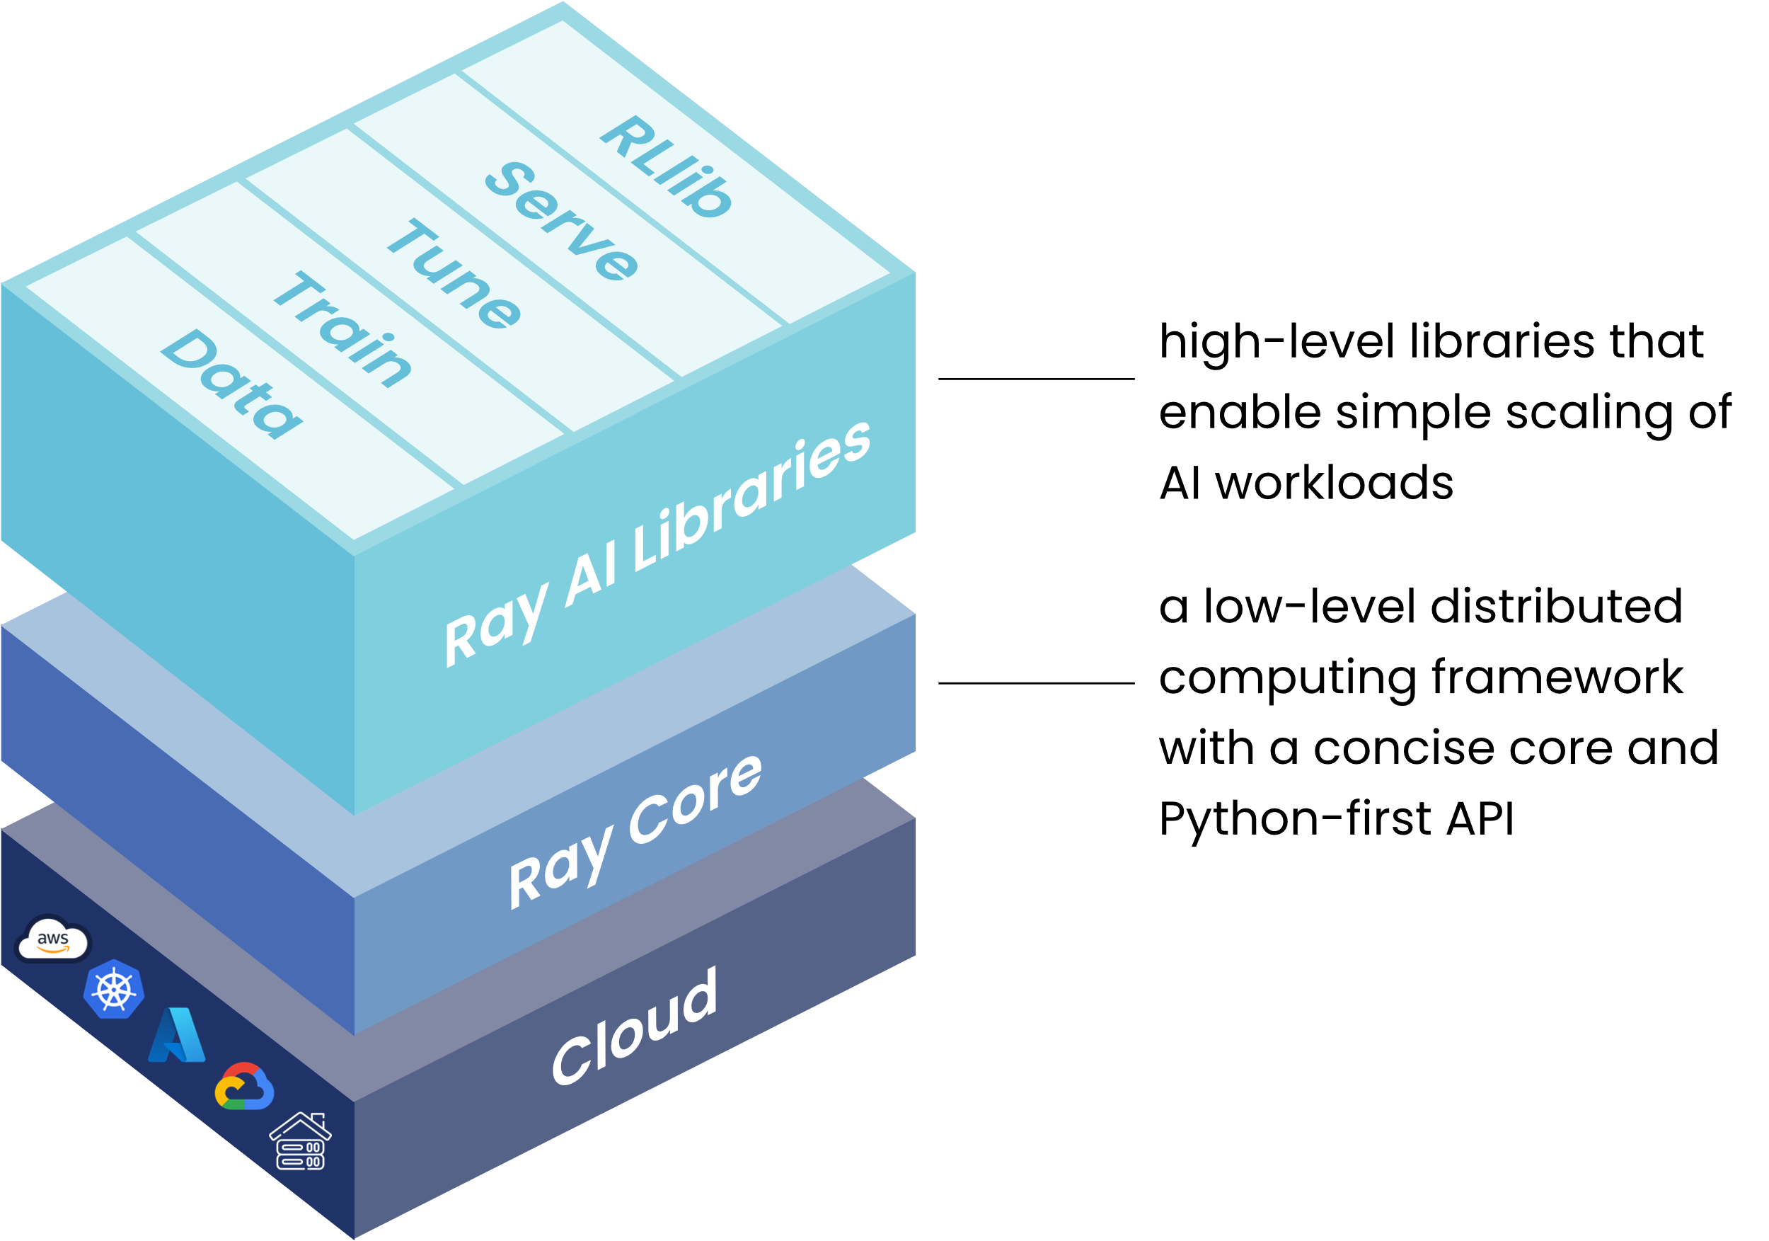
Ray framework
Ray’s unified compute framework consists of three layers:
Ray AI Libraries–An open-source, Python, domain-specific set of libraries that equip ML engineers, data scientists, and researchers with a scalable and unified toolkit for ML applications.
Ray Core–An open-source, Python, general purpose, distributed computing library that enables ML engineers and Python developers to scale Python applications and accelerate machine learning workloads.
Ray Clusters–A set of worker nodes connected to a common Ray head node. Ray clusters can be fixed-size, or they can autoscale up and down according to the resources requested by applications running on the cluster.

Slide 16
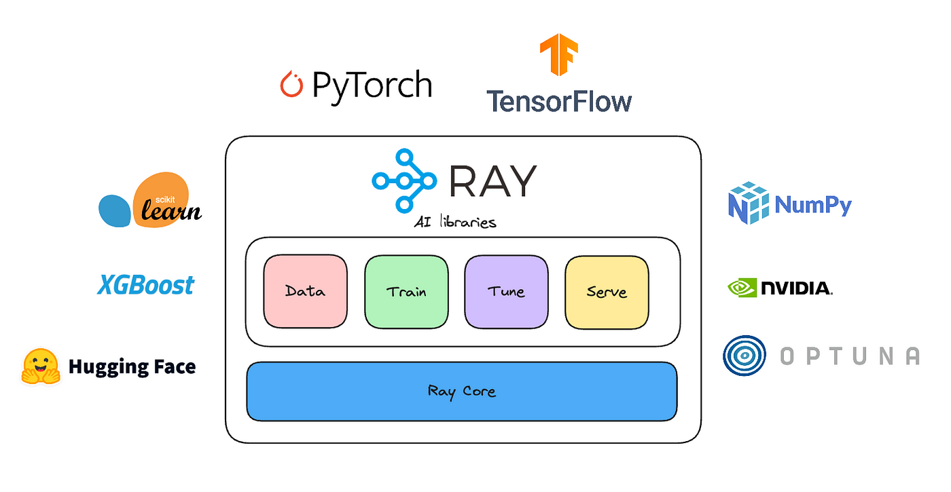
Ray Libraries:
Data: Scalable, framework-agnostic data loading and transformation across training, tuning, and prediction.
Train: Distributed multi-node and multi-core model training with fault tolerance that integrates with popular training libraries.
Tune: Scalable hyperparameter tuning to optimize model performance.
Serve Scalable and programmable serving to deploy models for online inference, with optional micro batching to improve performance.
RLlib: Scalable distributed reinforcement learning workloads.

Slide 17
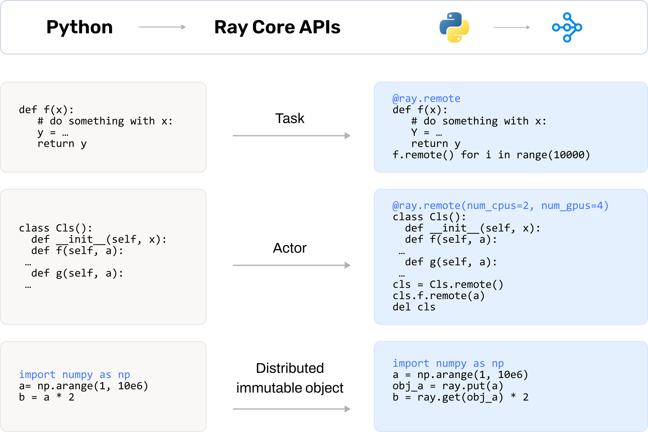
Parallel Processing
Ray is Python-native. Effortlessly scale from your computer to the cloud with one Python decorator. Plus, leverage and parallelize CPUs and GPUs in the same pipeline to increase utilization and decrease costs.
Ray Core and its key abstractions:
Tasks: Stateless functions executed in the cluster.
Actors: Stateful worker processes created in the cluster.
Objects: Immutable values accessible across the cluster.

Slide 18
Why Ray?
Today's ML workloads are increasingly compute-intensive. As convenient as they are, single-node development environments such as your laptop cannot scale to meet these demands.
Ray is a unified way to scale Python and AI applications from a laptop to a cluster.
With Ray, you can seamlessly scale the same code from a laptop to a cluster. Ray is designed to be general-purpose, meaning that it can performantly run any kind of workload. If your application is written in Python, you can scale it with Ray, no other infrastructure required.

Slide 19
Code Implementation

Slide 20
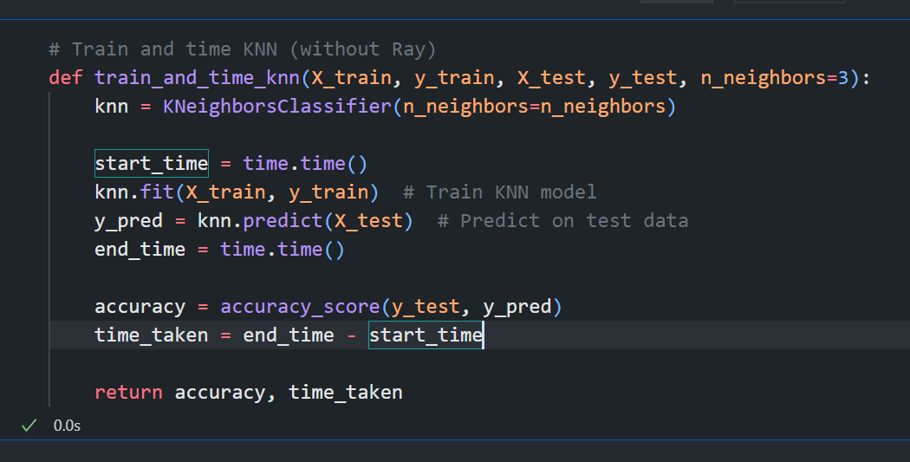
In the serial implementation, the algorithm calculates distances and classifies points sequentially, which becomes computationally intensive for large datasets.
Serial Implementation of kNN without Ray
CODE SNIPPET:

Slide 21
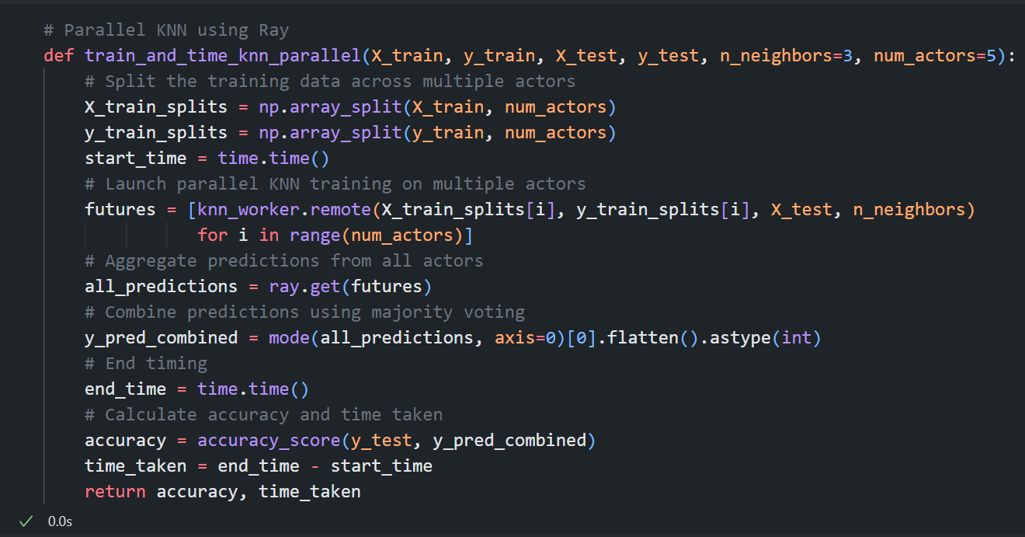
To overcome the serial approach's limitations, the KNN algorithm was parallelized using Ray, distributing distance computations and classification tasks among workers.
Distributed Implementation of kNN with Ray
CODE SNIPPET:

Slide 22
Experimental Results

Slide 23
Comparison with Traditional KNN
Sequential kNN for k=3
Metric | Dataset Name | Value | Observation
Accuracy (%) | Iris Dataset 150 Instances 4 Features | 82.62% | High accuracy for a small, well-defined dataset.
Execution Time |  | 5.6645 seconds | Quick execution due to small dataset size.
Accuracy (%) | Synthetic Dataset 1 1,00,000 Instances 10 Features | 84.25% | High accuracy with detailed features.
Execution Time |  | 9.4014 seconds | Longer execution due to larger dataset size.
Accuracy (%) | Synthetic Dataset 2 1,00,000 Instances 20 Features | 82.62% | Reliable for regional and case-based data.
Execution Time |  | 15.7331 seconds | Significant time due to high feature count.

Slide 24
Distributed kNN(Ray) for k=3
Metric | Dataset Name | Value | Observation
Accuracy (%) | Iris Dataset 150 Instances 4 Features | 100.00% | Slight improvement in accuracy with Ray.
Execution Time |  | 2.8274 seconds | Ray significantly speeds up execution
Accuracy (%) | Synthetic Dataset 1 1,00,000 Instances 10 Features | 86.23% | Handles complex datasets effectively.
Execution Time |  | 8.7632 seconds | Reduced Execution time with Ray
Accuracy (%) | Synthetic Dataset 2 1,00,000 Instances 20 Features | 85.63% | Scales well for high dimensional data
Execution Time |  | 11.5982 seconds | Significant reduction in execution time.

Slide 25
Sequential kNN for k=5
Metric | Dataset Name | Value | Observation
Accuracy (%) | Iris Dataset 150 Instances 4 Features | 100% | Improvement with higher K.
Execution Time |  | 0.0090 seconds | Quick execution.
Accuracy (%) | Synthetic Dataset1 1,00,000 Instances 10 Features | 85.16% | Handles larger datasets with higher accuracy.
Execution Time |  | 11.3250 seconds | Higher execution time due to complexity.
Accuracy (%) | Synthetic Dataset2 1,00,000 Instances 20 Features | 84.38% | Handles high-dimensional data effectively.
Execution Time |  | 168.9837 seconds | Significant increase in execution time.

Slide 26
Distributed kNN(ray) for k=5
Metric | Dataset Name | Value | Observation
Accuracy (%) | Iris Dataset 150 Instances 4 Features | 100.00% | No significant change with higher K in Ray.
Execution Time |  | 1.1355 seconds | Ray accelerates execution (similar to K=3).
Accuracy (%) | Synthetic Dataset1 1,00,000 Instances 10 Features | 86.39% | Continues to handle complexity effectively.
Execution Time |  | 10.2166 seconds | Ray maintains faster processing for large data.
Accuracy (%) | Synthetic Dataset2 1,00,000 Instances 20 Features | 86.16% | Scales well for high-dimensional datasets.
Execution Time |  | 69.5365 seconds | Significant advantage for complex datasets.

Slide 27

Future Work
Cluster Deployment:
Scaling up to a cloud environment for handling even larger datasets.
GPU Acceleration:
Leveraging GPUs to further reduce execution time.
Comparison with distributed kNN on Apache Spark:
Real-World Applications:
A detailed comparison between distributed kNN implemented using Ray and Apache Spark, analyzing their scalability, efficiency, and ease of use.
Testing distributed kNN in areas like image recognition, anomaly detection, and recommendation systems.

Slide 28
Conclusion
This project shows that distributed kNN using Ray not only improves execution time but also slightly enhances accuracy, especially for large and high-dimensional datasets. While traditional kNN performs well on small datasets, Ray’s scalability and efficiency make it a superior choice for big data applications. Further exploration in cluster environments and real-world scenarios can unlock its full potential.

Slide 29
References
1. Pumperla, M., Oakes, E., & Liaw, R. Learning Ray: Flexible Distributed Python for Machine Learning. O’Reilly Media, 2023.
2. Ray Documentation - Distributed Computing for Machine Learning.
[Link: https://docs.ray.io/en/latest/index.html].
3. Databricks_documentation: https://docs.databricks.com/en/machine-learning/ray/index.html
4. https://www.geeksforgeeks.org/k-nearest-neighbours/

Slide 30
THANK YOU

